Slide 1






Stack Overflow Developer Survey
Analysis
By Javier A. Jaime-Serrano
May 18th, 2021

Slide 2



OUTLINE
Executive Summary
Introduction
Methodology
Results
Visualization – Charts
Dashboard
Discussion
Findings & Implications
Conclusion
Appendix

Slide 3

EXECUTIVE SUMMARY
Stack Overflow performs annually a comprehensive survey of people who code around the world and covers everything from developers’ favorite technologies to their job preferences.
Key Findings:
JavaScript, HTML/CSS, Python, SQL and TypeScript are the most desired programming languages
Python is the fastest growing major programming language
PostgreSQL, MongoDB, Redis, MySQL, Elasticsearch are the most desired databases
NoSQL is getting more popular

Slide 4

INTRODUCTION
Stack Overflow Annual Developer Survey identify early trends from people who code around the world, from favorite technologies to job preferences.
- It helps to Identify future skill requirements
- The most desire programming languages in the future
- The top database future demands
- The most popular Platforms, IDEs & web Frames
- And the job preferences and Demographics
The intended audience is IT and HR Professionals

Slide 5

METHODOLOGY
Data Collection Sources
Stack Overflow Developer 2019 Survey
GitHub Job Postings API
Programming Languages Annual Salary
Data Exploration with Python
Data Cleaning with Python
Data Visualization with Python & Cognos Analytics
Presentation

Slide 6
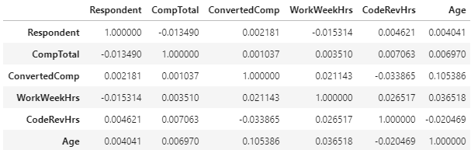
RESULTS
The following table show the correlation between age and ConvertedComp (Salary)

Slide 7
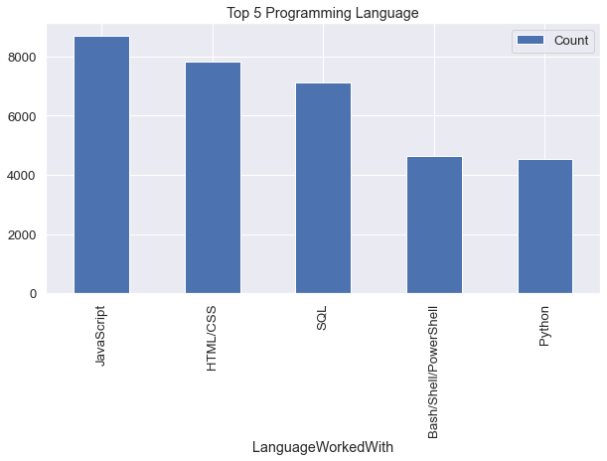
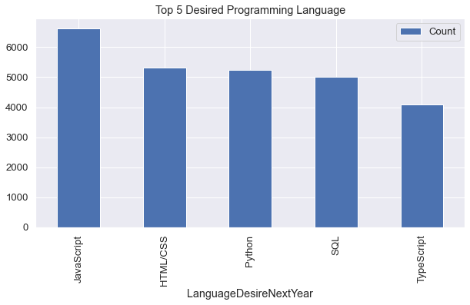
PROGRAMMING LANGUAGE TRENDS
Current Year
Next Year

Slide 8
PROGRAMMING LANGUAGE TRENDS - FINDINGS & IMPLICATIONS
Findings
JavaScript, HTML/CSS, SQL were at the top in 2019
JavaScript continue to be the leader
Python is becoming more popular
Implications
Web development and JavaScript will continue to be in high demand
Python is the preferred choice for Data Science and AI/ML
Business still require SQL

Slide 9
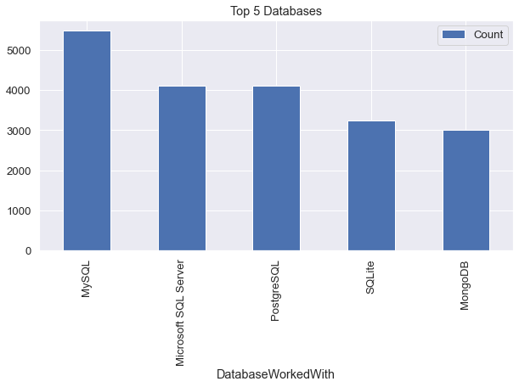
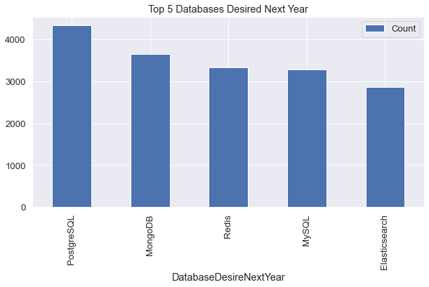
DATABASE TRENDS
Current Year
Next Year

Slide 10
DATABASE TRENDS - FINDINGS & IMPLICATIONS
Findings
Open Source databases are being preferred
PostgreSQL the most desired relational database
NoSQL MongoDB and Redis are becoming favorites
Implications
Business still using relational databases but prefer Open Source
MySQL and SQL Server are being challenged
NoSQL databases are more commonly used

Slide 11

DASHBOARDS
DASHBOARDS LINK
https://dataplatform.cloud.ibm.com/dashboards/76b49209-505f-4563-8266-6e880e5999db/view/0562fc2c3ab62ed76debd4e4079e7f037c31270ee7bbd55581827b4959657897f06d46c0c8791f5fdc10046bf1ef410d9b

Slide 12
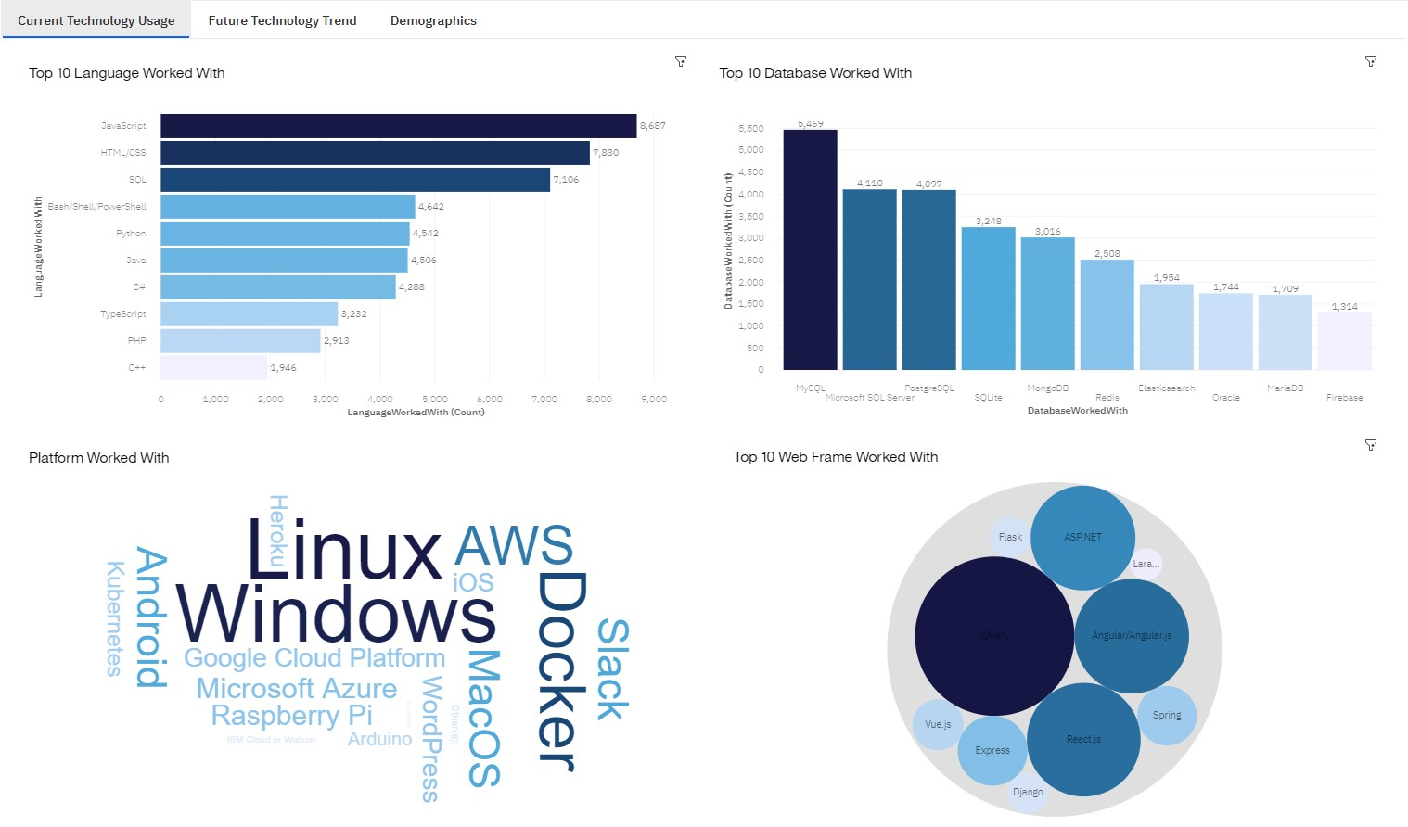

Slide 13
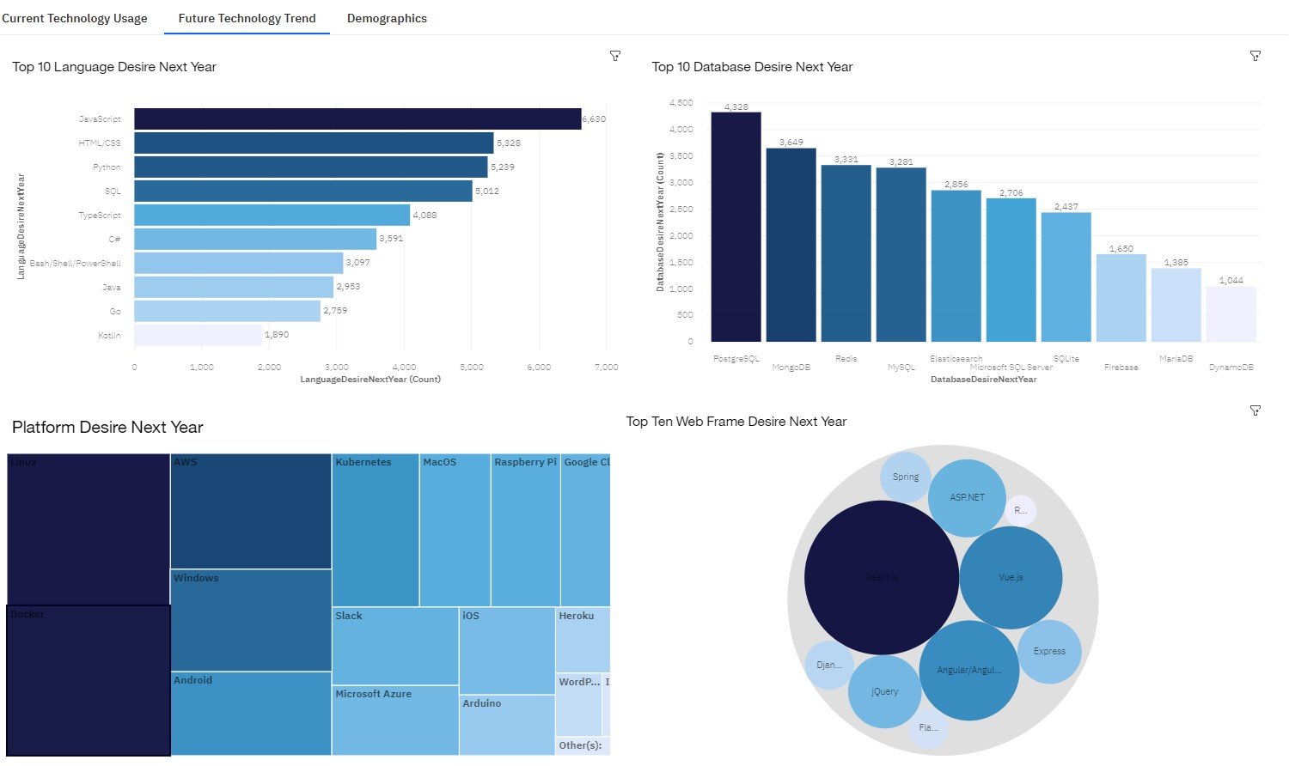

Slide 14
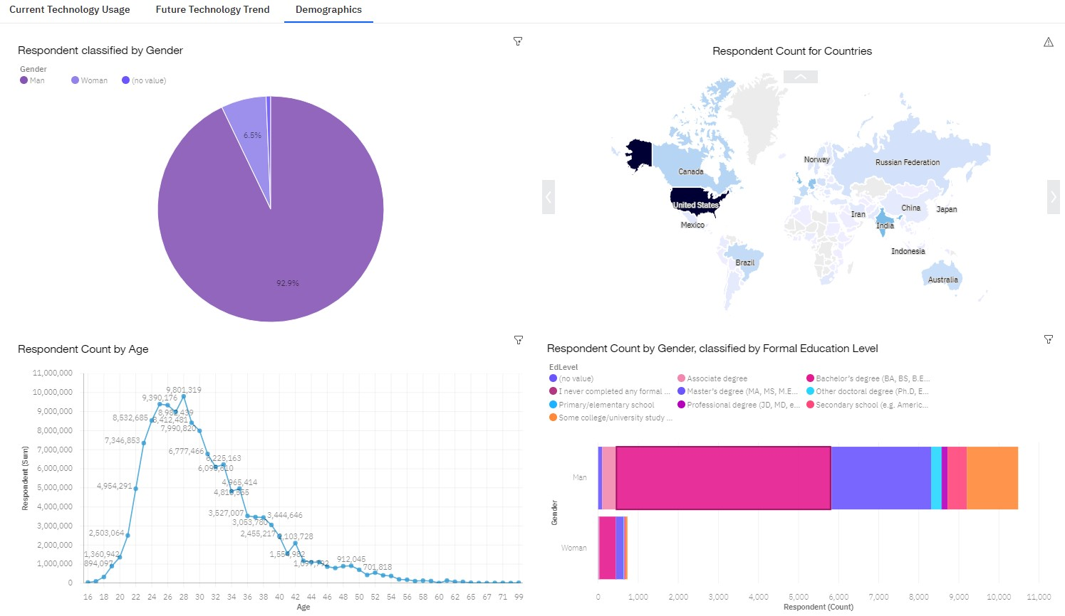

Slide 15
DISCUSSION
The most popular languages to learn, Python for DS, AI & ML
Need training and reskilling of workers
Need to improve female participation
Salary will follows skills needs

Slide 16
OVERALL FINDINGS & IMPLICATIONS
Findings
JavaScript continue to lead, for web development
Python the most desirable for Data Science and AI/ML
The average salary is passing the six figures (USD)
The gender gap in technology
Implications
Business are adapting to new technologies: Cloud, Open Source, NoSQL etc.
Salaries are increasing according to skills needs
Watch the gender gap

Slide 17

CONCLUSION
The technology trends show us the languages to choose and learn
Business need to adapt fast
The gender gap need to be narrowed
Web development and JavaScript will continue to be important
Data Science and AI/ML will continue to prop Python to the top
NoSQL Databases to be more common

Slide 18

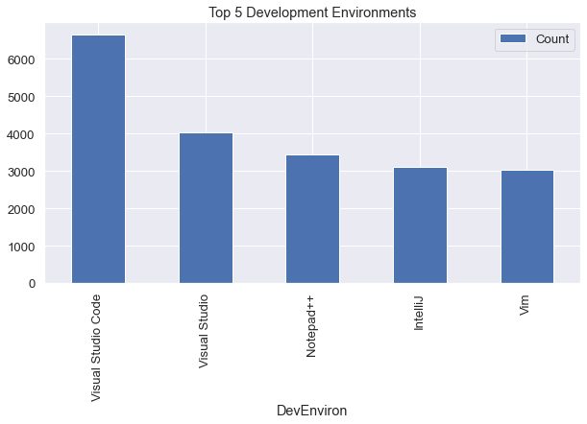
APPENDIX

Slide 19
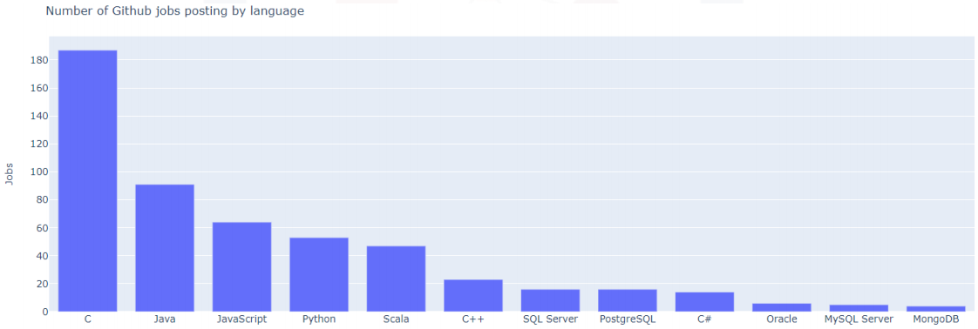
GITHUB JOB POSTINGS

Slide 20
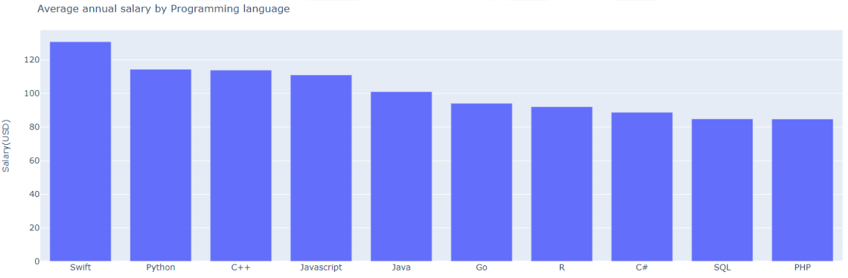
POPULAR LANGUAGES

